Slide 1
Engineering Induction Training Program (E-ITP)
Software Product Engineering Part 1
Motorola Software Group
Argentina Software Center

Slide 2
Software Product Engineering Topics
Overview
Formal Process Definition
Software Production Process
Software Life Cycles
Project Roles & Responsibilities
Project Planning Phase
Requirements Development Phase

Slide 3
Overview - What is Software Engineering?
The application of a systematic, disciplined, quantifiable approach to the development, operation, and maintenance of software; that is, the application of engineering to software (IEEE Std 610 -1991)

Slide 4
Overview - Why Formal Software Engineering?
Development of Software Standards
Define Formal Processes and Practices
Improve Visibility to Flaws
Understand Sources of Error or Variability
Improve Quality
Reduce Time of delivery
Reduce cost (and risk)
Improve “Portability” of effort
Notes:
These are only some of the reasons that we need software engineering practices.
Ultimately, if we do not have a standard set of disciplines, we will find it very hard to improve how we do things

Slide 5
Formal Process Definition
Process Definition
Elements of a Process

Slide 6
Process Definition
A Process is a systematic Way of Doing Things
A Process is a method of doing or producing something
A Process is a defined set of tasks
A Process is a sequence of tasks
A Process facilitates the completion of an objective
Activity
Activity
Activity
Notes:
This next section of slides summaries the SPP framework for software processes
Re-emphasize the definition of SPP
SOFTWARE PRODUCTION PROCESS

Slide 7
What is a Software Process?
Whenever we perform any software development activity we follow a process
  may be ad hoc
  may be defined
Whenever we refer to a process from hereon, we are referring to a defined software development process

Slide 8
What is a Software Process?
Input
Output
Software Process
Phase 2
Phase 3
Phase 1
Phase 4
Activity
Activity
Activity
Deliverables

Slide 9
Elements of a Generic Process
Inputs
Outputs
Steps to be performed (activities)
Roles and Responsibilities

Slide 10
Why define a Process?
A defined software process is a tool for the planning and controlling of software projects and processes
Makes planning and tracking easier
  estimation, scheduling, resource allocation, allocation of roles and responsibilities
  progress of activities against plans (estimates)
Leads to greater productivity and reduction in project cycle time
Starting point for improving organizational software development

Slide 11
Process
Guidance - What to do first
Predictability
Better than ad-hoc method
Repeatable -Establishment of standard procedure
Progress is measurable
Gives management capability
Notes:
A short recap on why we want to have formal processes again
this was presented in week 1

Slide 12
Software Production Process (SPP)

Slide 13
Requirements of a Process
Assure high quality software is developed
Minimize development cycle time
Maximize engineering productivity
Allow for learning from project experience

Slide 14
About the SPP
The SPP establishes the processes through which quality software is produced economically, on time, and in compliance with organizational standards
Is designed to support a CMMI L5 organization and is compliant with ISO 9001:2000.
The MASC SPP is based on MIEL’s (India) SPP
Is a template for a generalized project
  Must be tailored where necessary to suit a project’s specific characteristics

Slide 15
SPP Framework
The SPP is based on a process framework which consists of:
  Preview
  Activities
  Quality gate
  Measurement
  Deliverables
  Documents
  Post mortem

Slide 16
SPP Framework
Quality Gate
Preview
Activity
Post mortem
Measurement
Measurement
Measurement

Slide 17
Valid Input
An input to the process with a known level of quality
May be the output from a previous activity or an externally sourced artefact

Slide 18
Preview
Communication to all team members the detailed plan of an activity
Produce a common understanding of the purpose and expected outcome of an activity
Conducted for the benefit of the project team

Slide 19
Activities
e.g. Design, Coding, System Testing
All process activities must add value to the project
Results are captured in a set of artefacts
These artefacts pass through a quality gate
artefacts = deliverables
Notes:
This is the actual activity

Slide 20
Quality Gate
A check to determine whether or not an activity’s output is fit for its intended purpose
The purpose of the output should be agreed to at the activity preview
The common forms of quality gate are:
  peer review (inspections)
  testing

Slide 21
Measurement
The collection of metrics about the project, product and process
  time spent in an activity
  faults found
  estimated and actual data for an activity
Used for monitoring and correcting the project
Used for improving the organization

Slide 22
Deliverables
This is the specific output of a specific activity
  it may be a document or a specification
  it may be a plan
  it may be a code
  it may be a test case or script
  it may be test results
Notes:
It might be of value to introduce the concept of a Configuration Item here
…some of these documents (most of them in fact) will be kept and retained over time….
where do they get stored?
And do they get stored in an organized (and retrievable) manner

Slide 23
Documents
The minimum record of an activity which satisfies the requirements of the activity
  a document to send to a customer
  a document to record a meeting
  a document to record the design
  At a minimum, there is generally some record of who completed what activity, at what time, (so that others, including the project leader, know that the task is done).
Notes:
At a minimum, there is generally some record of who completed what activity, at what time (so that others, including the project leader, know that the task is done)
It might be of value to introduce the concept of a Configuration Item here
…some of these documents (most of them in fact) will be kept and retained over time….
where do they get stored?
And do they get stored in an organized (and retrievable) manner

Slide 24
Postmortem
Mechanism for learning from the completed activity
Generally held at the end of the activity before the next activity starts
Discover strengths and weakness of the process
Promote best practices to the organization
Conducted for the benefit of the project team and the organization

Slide 25
Software Production Process (SPP)
Software Development Phases
  Project Planning
  Requirements Development
  Architecture and Design
  V&V Test Development
  Code and Unit Testing
  Integration
  V&V Test Execution
  Software Release
Notes:
These are the basic phases in the SPP

Slide 26
GSG Software Production Process
Product Development
Requirements Development
ICD (optional)
PV
REQB
RTMX
SRS
PV
SDD
PV
Code
RTMX
SAD
Requirements Gathering
Requirements
Analysis
Architecture
& Design
Code &
Unit Testing
-Software
Ad
Ad
Integrated
Release
RV
Ad
PM
RV
PM
PV
System
PV
PV
-Release
PM
RV
Notes
Project
Integration
V&V Test
Release
Initiation
VVTC
Execution
PSCMP
SPMP
SQAP
VVTP
Ad
RRR
PV
VVTD
Ad
PM
RV
RV
RV
PCA
Project
Planning
V&V Test
Test
FCA
Development
Execution
RV
Ad
PM
PV
Ad
PM
RV
Test Development
Describes the flow – Not a life cycle
Notes:
Here are the same phases in the ITP’s V model

Slide 27
SPP Acronym’s
SPP Software Production Process
REQB Requirements Book
ICD Interface Control Document
SRS Software Requirements Specifications
SPMP Software Project Management Plan
SCMP Software Configuration Management Plan
SQAP Software Quality Assurance Plan
PV Preview
RV Review
PM Post Mortem
SDD Software Design Document
SAD Software Architecture Document
UT Unit Test
TRR Test Readiness Review
RRR Release Readiness Review
TRS Test Result Summaries
Ad Audit
VVTP Verification and Validation Test Plan
VVTD Verification and Validation Test Design
VVTC Verification and Validation Test Cases

Slide 28
SPP Inviolates
Project Planning
Process Framework
Preview and Postmortems
Records and Metrics
Quality Control
Configuration Management

Slide 29
Software Life Cycles

Slide 30
Development Life Cycle Models
Definition 1: A description of the activities over a project’s lifetime on high level of abstraction
Definition 2: Software development process is a set of activities carried out in a particular sequence and this is captured by a model in a very abstract manner
Notes:
Now a new section…let’s review lifecycles
We have looked at the process that we use for the E-ITP, but note, there are other ways that these same phases can be sequenced and organized.
Different lifecycles reflect slightly different processes and the use of different lifecycles would require a planned deviation or change from the standard model

Slide 31
Lifecycle Models
Lifecycle Models Include:
  Waterfall
  Cascading Waterfall
  V -Model
  Spiral
  Incremental
  Evolutionary/Rapid Prototyping
For this ITP we will use a modified V-Model.
Notes:
Mention that other lifecycles exist and each has its particular advantages and disadvantages
these will be discussed in the second week’s lectures

Slide 32
About Life Cycle Models
A tool for project planning and tracking
A model of project progress
Independent of the methods & procedures within each activity of the lifecycle
Very abstract

Slide 33
Taxonomy of Life Cycles
There are three basic types of Life Cycles
  Sequential
  Iterative
  Recursive
    Note: All Recursive Models are iterative but not all iterative models are recursive
Notes:
There are three basic types of lifecycles
sequential (you go from one phase to the next in order)
Iterative (you can go back and repeat previous phases)
recursive (you must go back and repeat previous phase…indeed the entire process itself may be repeated in its entirety)
Discuss what recursion and iteration mean.
An iterative loop in programming is a DO loop. It repeats the same steps over and over again, based upon some control or gating mechanism
A recursive call, in the C language, allows a subroutine to actually call itself. Recursion in programming can be tricky and dangerous.

Slide 34
Types of Life Cycles Models
Waterfall
V Model
VP Model (V Model with Prototyping)
Incremental
Evolutionary Model
Notes:
Here are some of the Lifecycles that will be discussed

Slide 35
Waterfall Model
Requirements
Development
Arch &Design
Code
Test
Notes:
In this model, the project progresses through an orderly sequence of phases that are discontinuous, they do not overlap. The project holds a review at the end of each phase to determine whether it is ready to advance to the next step phase. If the review determines that the project isn’t ready to move to the next phase, it stays in the current phase until it is ready
This model performs well for product cycles in which you have a stable product definition and when you’re working with well-understood technical methodologies.
It helps to minimize planning overhead because you can do all the planning up front. It doesn’t provide tangible results in the form of software for the Customer until the end of the life cycle.
This model works well for projects that are well understood but complex, because you can benefit from tackling complexity in an orderly way. It works well when quality requirements dominate cost and schedule requirements. Elimination of midstream changes eliminates a huge and common source of potential errors.

Slide 36
Waterfall Model
Strengths
  It helps to minimize planning overhead because you can do all the planning up front
  Easy to manage : simple flow of activities
  Easy to estimate : distinct phases
Weaknesses
  It is not flexible
  It is not possible to go to the next phase before it’s finished the current one
  There is no working system produced, until the very end

Slide 37

V Model
SOFTWARE
V&V TEST
V&V
REQUIREMENTS
PLANNING
TESTING
PRELIMINARY
INTEGRATION
INTEGRATION
DESIGN
TEST PLANNING
TESTING
DETAILED
UNIT TEST
UNIT
DESIGN
PLANNING
TESTING
CODING

Slide 38
V Model
Strengths
  Easy to manage : simple flow of activities
  Easy to estimate : distinct phases
  Emphasis on Verification and Validation.
Weaknesses
  Needs stable and well understood requirements
  Long time between project start and any product delivery
  Does not handle risks well

Slide 39
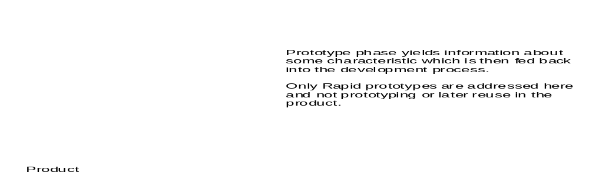
VP Model (V Model with Prototyping)
Notes:
Adding prototyping to the V model enables the project to handle minor uncertainties and risks. These include feasibility issues at the requirement stage, performance issues at the design stage or the situation that a new tool or system is outsourced whose features/performance are unknown.
The prototyping phase could be to:
Explore a space of possible solutions. This is a suitable approach if there is risk and uncertainty about the problem, e.g. human interface (with new devices/first time users), system performance, error and fault management.
Listing alternate solutions and evaluating them against some predefined criteria. This is suitable if there is risk and uncertainty about the solution, e.g. precise functionality about a “middleware” (OS, database, communication protocol, windowing system, etc.), performance of a vendor supplied middleware, performance of one of the tools, performance of a particular design under various loads

Slide 40
VP Model
Strengths
  Enables the project to handle minor uncertainties and risks
  Demonstrates progress at completion of each prototype
  Reduces uncertainty.
Weaknesses
  project schedules can be committed only after the results of the prototype phase are evaluated
  involves a high degree of user participation
Notes:
Strengths and weakness of the Spiral model

Slide 41
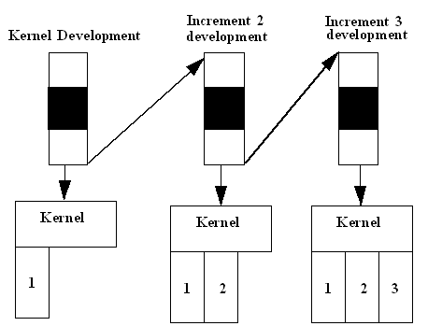
Incremental Model
Notes:
The system is delivered in a number of increments. Each delivery is usable but has only partial functionality. Each delivery adds additional functionality to the previous delivery. The final delivery is the complete system.
The incremental model is suitable if the customer requires a subset of the system before the entire system can be produced.
The incremental model is useful in projects where most of the requirements are understood, but they are expected to evolve over time.
This model has the advantage of reducing external (hardware and software) interface risks early in the product lifecycle.
Since each increment is well understood either the V or VP lifecycle model can be used for development.

Slide 42
Incremental Model
Strengths
  Early delivery to customer
  Customer can make use of a subset of the system before it is fully finished.
  Reduces external interfaces risks
Weaknesses/Constraints
  Needs stable requirements
  Must carefully choose the system core
  Success of this model rests on the project team's ability to create an extensible architecture and design
  Testing strategies should be linked to the planned build strategies with strong focus on regression testing.
Notes:
Again, this results in faster delivery of partial functionality to the customer.
However, you need a pretty good idea of what is ahead before you can break down development this way.
If requirements are vague or unstable, this type of incremental development can be disastrous

Slide 43
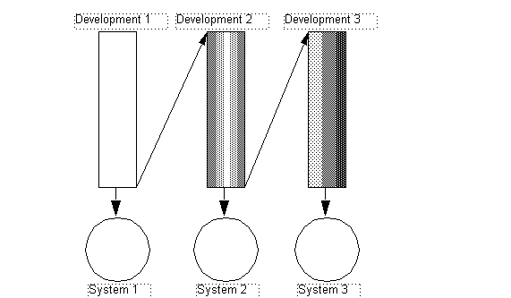
Evolutionary Model
Notes:
A whole series of complete systems is developed. Each system is complete in that it provides full functionality to the user.
Once a system is built and used, changes are identified and incorporated in the requirements for the next system in the series, which is then produced. The changes might include changes to functionality, changes in user interface, changes in non-functional characteristics such as reliability and changes to implementation to, for instance, improve speed and performance.
The evolutionary model is useful if the requirements are unclear, or they are expected to evolve.
If database or files used change between versions, version information should be embedded on the data to enable conversion utilities to properly update the data.
The V or VP model can be used to build each system depending upon its nature

Slide 44
Evolutionary Model
Strengths
  Useful when the requirements are unclear
  Delivers early to customer
Weaknesses/Constraints
  Relies on the designers developing a system which is easily modifiable
  Fully Recursive Model repeating all tasks
  Change control and configuration management should be designed to address the identification of different versions and their release
Notes:
Note, if previous version are not easily changeable, this can cause major problems. Subsequent cycles become progressively more difficult because there is more and more to change.

Slide 45
More about Life Cycle Models
Each model progresses through the same series of steps
  only the amount of work done in each step varies
Each model could be drawn as a linear sequence of steps
  the different arrangements serve to illustrate the emphasis of the model

Slide 46
Selecting a Life Cycle Model
Depends on many factors such as:
  technical risks
  managerial risks
  requirements volatility
  required cycle time
  customer issues
  team size
Notes:
Typical questions to be asked in analyzing the risks and uncertainty factors in a project are:
How well are the system requirements understood and finalized?
What is the likelihood of unknown/missed requirements?
What is the level of uncertainty in the requirements i.e., requirements are defined, but no knowledge of past, present or future events that impact requirements?
How volatile are the requirements?
What is the risk of schedule slippage when attempting to deliver all specified requirements?
Is the customer prepared to wait for the completion of the entire system before they receive any software?
What is the risk of resources being unavailable when required?
Is the product development technology new or existing? What is the level of experience of the team members with the development technology?
What is the project complexity i.e., the number of sub-systems, number of disciplines, and novelty of technology?
How much reuse of product and documentation deliverables is possible during the development?
What is the longevity of the product?
What is the technical risk involved in the project? Is it possible to implement the functional and non-functional requirements of the product?

Slide 47
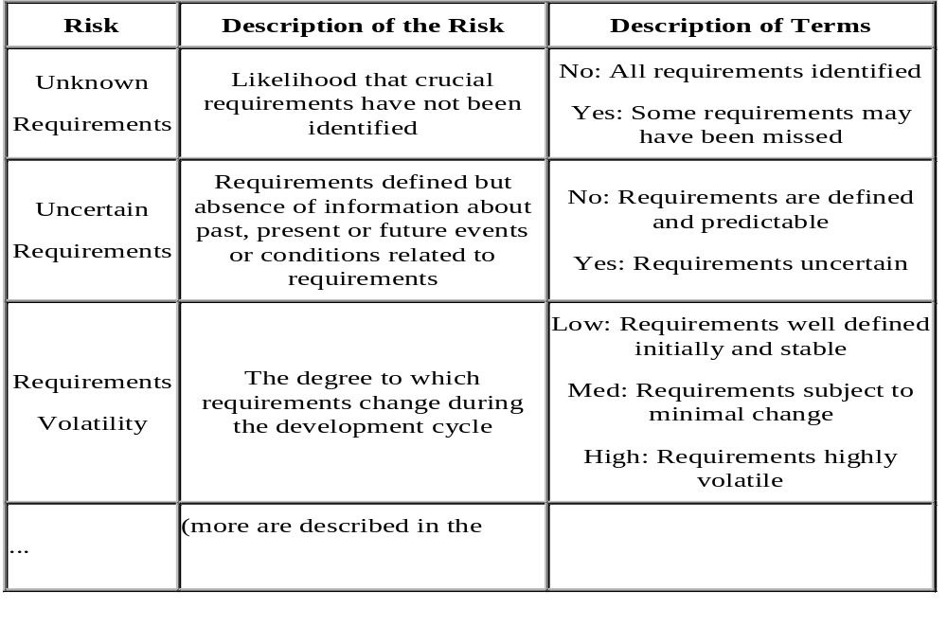
Risk Assessment Matrix
“Process Tailoring Guidelines”)

Slide 48
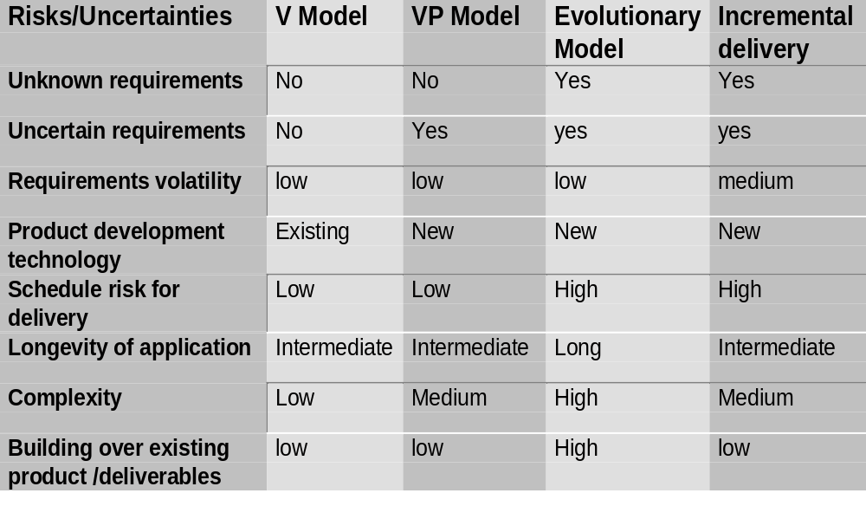
Life Cycle Model Selection Matrix
Notes:
Here is a matrix comparing some aspects of different approaches
Note, this is an opinion of one author. There are other reasons that you might prefer to use on style over another.
Some lifecycles are more…controlled and detailed.
This would be appropriate for more inexperienced practitioners (but because of greater complexity, it might require a more experience project manager)
Other models (like the waterfall) are simpler and might be appropriate if you have very experienced practitioners who do not need as much formal control
Note that simpler models are easier to manage but give the programmers more leeway to do things wrong.
Conversely, the more complex models ensure greater reliability and control but require greater project management expertise.

Slide 49
Vertical and Horizontal Elements
Project Planning and Tracking
Configuration Management
Requirements
Analysis
Design
Code
Test
Software Quality Assurance
Measurement and Analysis
Notes:
Vertical elements are those represented by the activities in a life cycle model
Horizontal elements are those which go on continuously throughout a project

Slide 50
GSG Software Production Process
Product Development
Requirements Development
ICD (optional)
PV
REQB
RTMX
SRS
PV
SDD
PV
Code
RTMX
SAD
Requirements Gathering
Requirements
Analysis
Architecture
& Design
Code &
Unit Testing
-Software
Ad
Ad
Integrated
Release
RV
Ad
PM
RV
PM
PV
System
PV
PV
-Release
PM
RV
Notes
Project
Integration
V&V Test
Release
Initiation
VVTC
Execution
PSCMP
SPMP
SQAP
VVTP
Ad
RRR
PV
VVTD
Ad
PM
RV
RV
RV
PCA
Project
Planning
V&V Test
Test
FCA
Development
Execution
RV
Ad
PM
PV
Ad
PM
RV
Test Development
Describes the flow – not a life cycle model

Slide 51
SPP Framework
Note, each activity in the SPP model conforms to the SPP Framework for a formal process
  Each activity is bracketed by a PREVIEW and a POSTMORTEM
  Each activity is accompanied with a QA Gate which accepts or rejects he product/process
  Each activity is measured
Notes:
Just a recap of the essential parts of a process again

Slide 52
SPP Project Roles and Responsibilities

Slide 53
Project Roles and Responsibilities
Project Team Roles
  Project Manager or Lead (PM, PJM, or PL)
  Technical Lead (TL)
  Configuration Manager (CM)
  Test Engineer (TE or STE)
  Software Engineers (SE or SSE)
  Quality Engineer (QE)
Project Support Roles
  Quality Specialist (QS or SQE)
  System Engineer (SyE)
Organizational Managers
  Operations Manager (OPM)

Slide 54
Project Planning Phase

Slide 55
Project Planning
Product Development
Requirements Development
ICD (optional)
PV
REQB
RTMX
SRS
PV
SDD
PV
Code
RTMX
SAD
Requirements Gathering
Requirements
Analysis
Architecture
& Design
Code &
Unit Testing
-Software
Ad
Ad
Integrated
Release
RV
Ad
PM
RV
PM
PV
System
PV
PV
-Release
PM
RV
Notes
Project
Integration
V&V Test
Release
Initiation
VVTC
Execution
PSCMP
SPMP
SQAP
VVTP
Ad
RRR
PV
VVTD
Ad
PM
RV
RV
RV
PCA
Project
Planning
V&V Test
Test
FCA
Development
Execution
RV
Ad
PM
PV
Ad
PM
RV
Test Development

Slide 56
Project Planning Activities
The Project Planning activity consists of:
  Development of Project Plans
    Software Project Management Plan (SPMP),
    Software Quality Assurance Plan (SQAP), and
    Project Software Configuration Management Plan (PSCMP)
Notes:
The Project Plans, i.e. Software Project Management Plans (SPMP), Software Quality Assurance Plans (SQAP), and Software Configuration Management Plans (SCMP) are developed in conjunction with the REQB. During planning the project lifecycle model and the project development processes shall be selected. The projects decisions regarding lifecycle and development processes shall be recorded in the project SPMP.

Slide 57
Project Planning Input
Mandatory inputs consist of:
  REQB
  Resource allocations from the Operations Manager (Ops)
Other possible inputs to this phase consist of:
  Defect Reports detailing defects which require resumption of this activity.

Slide 58
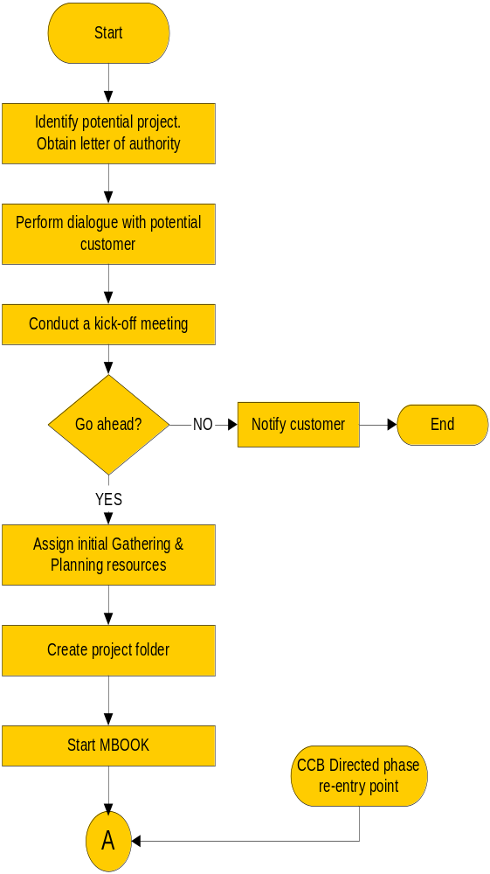
Project Planning
Activities Flow
Project Planning
Startup Flow
Project Planning
Documentation Flow
A
Z
Complete project
plans
Perform formal
NO
Start SQAP,
Start SPMP
reviews
PSCMP
OK?
YES
Customer agreement to
plans
---------------------------------------
PL commitment to plans
Finish SQAP,
---------------------------------------
Managers commitment to
PSCMP
plans
Baseline plans
---------------------------------------
Finish SPMP
Update MBOOK
Z
End

Slide 59
Kick Off Meeting
A project kick off meeting is held to mark the start of the project.
The kick off meeting is a forum for dissemination of information on any new project to assist in coordination between the project and support departments during project planning.
Attendees shall include:
  The Operation Manager,
  the Project Leader & the Technical Leader,
  any other engineers who have been assigned to the project,
  a representative from HR,
  a representative from Finance,
  Quality Specialist,
  a representative from Network & IT Administration,
  a representative from Process.
  a representative from Global Configuration Management Group
  Kick off meeting Guidelines
Notes:
Notes:
The kick off meeting shall be held as soon as a Project Lead is assigned to the project.
The requirements are merely predictions made before extensive Requirements Gathering and Planning has been carried out.
As the project support requirements can not be fully known at the time of the kick off meeting there shall be continual liaison between the project and the support departments during project planning. The level of communication is expected to be high during the initial project planning stages.

Slide 60
Project Planning Outputs
The following artifacts from this phase are baselined to form part of the Project Baseline:
  SPMP
  SQAP
  PSCMP
The following outputs are stored in the Project Folder:
  Kick-Off Meeting Minutes/Actions
  Project Plan Approval Minutes/Actions
  IQMEN (MBOOK for reporting)
  Quality Audit Report
  Formal Technical Review Reports
  Post-Mortem Meeting Minutes/Actions
  EOPC

Slide 61
Project Planning V&V
The following verification and validation activities are performed during this activity:
  Quality Audit
  Project Plan Review of:
    SPMP
    SQAP
    PSCMP
  Customer approval (if required) of:
    SPMP
  Post-Mortem
  Completion of the EOPC

Slide 62
Requirements Development Phase

Slide 63
Requirements Development
Product Development
Requirements Development
ICD (optional)
PV
REQB
RTMX
SRS
PV
SDD
PV
Code
RTMX
SAD
Requirements Gathering
Requirements
Analysis
Architecture
& Design
Code &
Unit Testing
-Software
Ad
Ad
Integrated
Release
RV
Ad
PM
RV
PM
PV
System
PV
PV
-Release
PM
RV
Notes
Project
Integration
V&V Test
Release
Initiation
VVTC
Execution
PSCMP
SPMP
SQAP
VVTP
Ad
RRR
PV
VVTD
Ad
PM
RV
RV
RV
PCA
Project
Planning
V&V Test
Test
FCA
Development
Execution
RV
Ad
PM
PV
Ad
PM
RV
Test Development

Slide 64
“The hardest single part of building a software system is deciding precisely what to build.”
[Brooks, No Silver Bullets, 1987]
Notes:
Why to perform Requirements Management?
Increase customer satisfaction and thus the quality of the product by understanding the user’s needs quality is satisfying the user’s needs
Reduce cycle time by getting it right the first time
To specify the requirements for the product completely, correctly and unambiguously to ensure it satisfies the customer’s needs
To ensure that the product delivered (which is the result of requirements specification, design, code and test) satisfies the requirements specified which is achieved by tracing the requirements through the software development process
What is a Requirement (IEEE Std 610.12 -1990)?
A condition or capability needed by an user to solve a problem or achieve an objective.
A condition or capability that must be met or possessed by a system or system component to satisfy a contract, standard, specification, or other formally imposed document.

Slide 65
Requirements Development vs. Requirements Management (CMMI)
The purpose of Requirements Development (RD) is to produce and analyze customer, product, and product component requirements.
The purpose of Requirements Management (REQM) is to manage the requirements of the project’s products and product components.
Notes:
Why to perform Requirements Management?
Increase customer satisfaction and thus the quality of the product by understanding the user’s needs quality is satisfying the user’s needs
Reduce cycle time by getting it right the first time
To specify the requirements for the product completely, correctly and unambiguously to ensure it satisfies the customer’s needs
To ensure that the product delivered (which is the result of requirements specification, design, code and test) satisfies the requirements specified which is achieved by tracing the requirements through the software development process
The project takes appropriate steps to ensure that the agreed-on set of
requirements is managed to support the planning and execution needs
of the project
The requirements changes, if any, might be documented in change requests from the customer or users, or they might take the form of new requirements received from the requirements development process.
What is a Requirement (IEEE Std 610.12 -1990)?
A condition or capability needed by an user to solve a problem or achieve an objective.
A condition or capability that must be met or possessed by a system or system component to satisfy a contract, standard, specification, or other formally imposed document.
Requirements Development encompasses requirements gathering and analysis as well as the traceability of requirements to design, code and tests.
In addition:
Requirements form the basis for all software planning and production activities
Requirements development ensures that changes to requirements are applied in a controlled manner
The development of requirements includes the Elicitation, Analysis, Validation, and Communication of customer needs, expectations, and constraints to obtain customer requirements that constitute an understanding of what will satisfy stakeholders

Slide 66
Types of Requirements
Functional requirements
  What the software needs to do.
Non-functional (Quality) requirements
  How the software will do it.
Notes:
Functional requirements
Statements of services the system should provide, how the system should react to particular inputs and how the system should behave in particular situations.
Characteristics:
Specify functions that the system or a system component must be able to perform
Describe functionality or system services
Depend on the type of software, expected users and the type of system where the software is used
Should describe the system services in detail
Non-functional requirements
Constraints on the services or functions offered by the system such as timing constraints, constraints on the development process, standards, etc.
Classification:
Product requirements: Requirements which specify that the delivered product must behave in a particular way e.g. execution speed, reliability, etc.
Organizational requirements: Requirements which are a consequence of organisational policies and procedures e.g. process standards used, implementation requirements, etc.
External requirements: Requirements which arise from factors which are external to the system and its development process e.g. interoperability requirements, legislative requirements, etc.
Characteristics:
Define system properties and constraints e.g. reliability, response time and storage requirements. Constraints are I/O device capability, system representations, etc.
Process requirements may also be specified mandating a particular CASE system, programming language or development method
Non-functional requirements may be more critical than functional requirements. If these are not met, the system is useless
Domain requirements
Requirements that come from the application domain of the system and that reflect characteristics of that domain
Characteristics:
Derived from the application domain and describe system characteristics and features that reflect the domain
May be new functional requirements, constraints on existing requirements or define specific computations
If domain requirements are not satisfied, the system may be unworkable

Slide 67
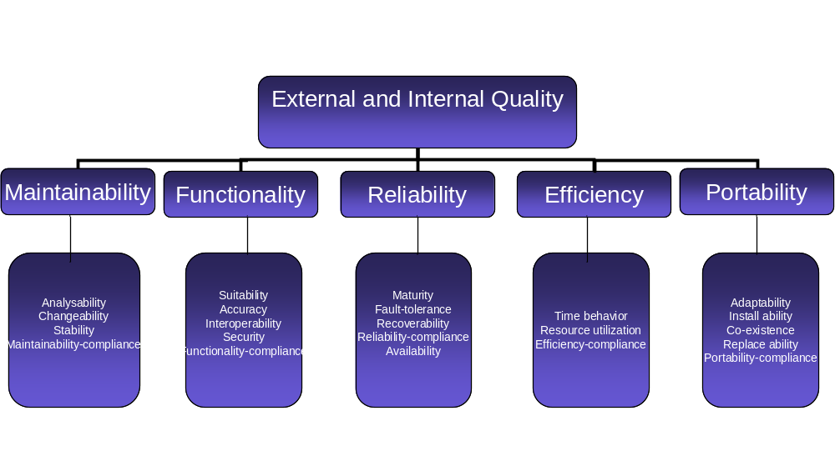
Non-functional requirement types

Slide 68
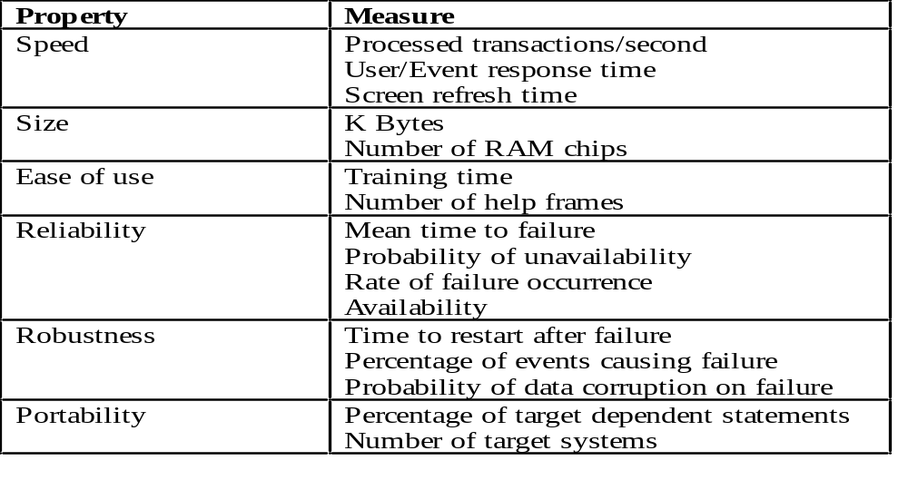
Non Functional Requirements Measures

Slide 69
Requirements Development Phase
Preview
Requirements
Summary
Development
Form
Preview
Requirements Development Preview: please note that the preview activity for this phase is done during the Project Planning phase.
Requirements Gathering: involves the discovering of the requirements of the system.
Requirements Analysis: establishes an agreed set of requirements which are complete and consistent.
Requirements Development Post Mortem
REQB
Requirements
Gathering
SRS
Requirements
Analysis
ICD
Post Mortem
Requirements
Summary
Development
Form
Post Mortem
Notes:
Requirements Development Preview: before the phase begins a preview meeting has to be performed in order to prepare the team for the activity about to be undertaken
Requirements Gathering: involves the discovering of the requirements of the system. System developers and engineers work with customers and end-users to find out about the problem to be solved, the system services, the required performance of the system, hardware constraints, and so on.
Requirements Analysis: establishes an agreed set of requirements which are complete and consistent. During the analysis process, missing requirements, requirements conflicts, ambiguous requirements, overlapping requirements and unrealistic requirements are normally discovered.
Requirements Development Post Mortem: once the phase has finished a post mortem activity has to be performed in order to capture the lessons learned

Slide 70
Requirements Gathering Process
Entry Criteria:
  Project contract has been signed.
  Marketing/System requirements have been signed. This entry criteria is optional for projects that do perform the system engineering phase.
Inputs, as appropriate:
  Business proposal / project definition document /Statement of work / Feasibility Reports / earlier prototypes, White Papers, Requirements Book from similar previous projects as applicable and available, etc.
  Stakeholder inputs, e.g. Tender Specifications, Request for Proposal (RFP), Timeline Scenarios, Marketing Requirements Document (MRD) as available.
One thing that you have to keep in mind is that there can be multiple iterations of this process depending on the nature of the project.
Notes:
Requirements characteristics:
Requirements imprecision
Problems arise when requirements are not precisely stated
Ambiguous requirements may be interpreted in different ways by developers and users
Requirements completeness and consistency
In principle requirements should be both complete and consistent
Complete: They should include descriptions of all facilities required
Consistent: There should be no conflicts or contradictions in the descriptions of the system facilities
Domain requirements problems
Understandability
Requirements are expressed in the language of the application domain
This is often not understood by software engineers developing the system
Implicitness
Domain specialists understand the area so well that they do not think of making the domain requirements explicit

Slide 71
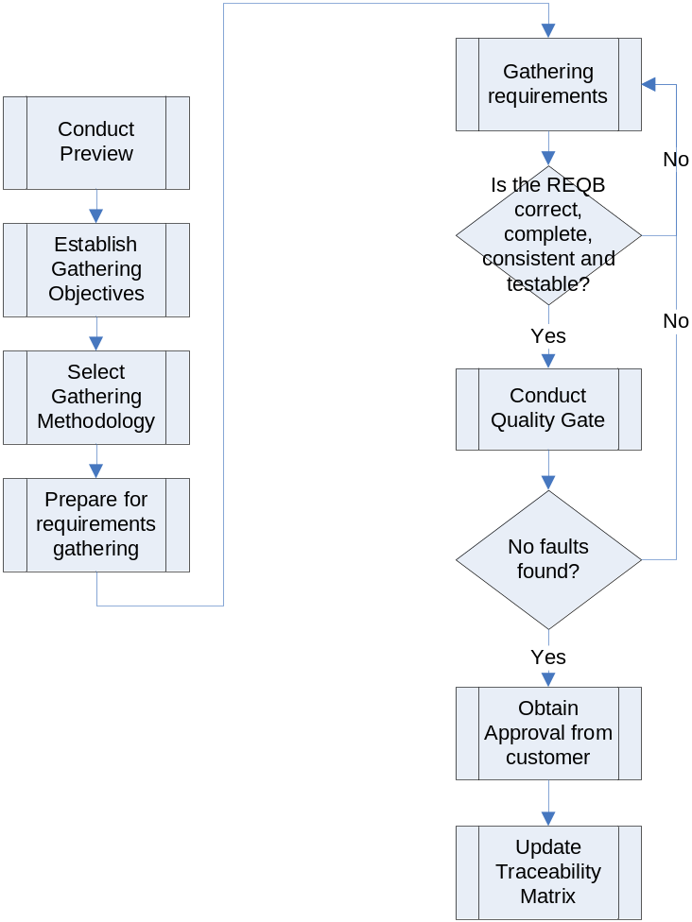
Requirements Gathering Process
Notes:
Conduct Preview: a preview meeting shall be conducted in order to identify the activities to be performed and the responsible for each identified activity.
Establish Gathering Objectives: the purpose of this activity is to define which are the objectives for the requirements gathering process, and identify the relevant stakeholders.
Select Gathering Methodology: the gathering methodologies are Interviews, Questionnaire or surveys, Brain Storming, Scenarios, Prototyping, etc. The developers have to select one or more of these methodologies in order to carry out the gathering.
Prepare for Requirements Gathering: the preparation includes the selection of the stakeholders, the development of surveys, schedule of the interviews, etc
Gather Requirements: the gathering of requirements involves the following tasks:
Elicitation of requirements from identified stakeholders.
Analysis of the elicited requirements looking for inconsistencies and ambiguities.
Specification of the analyzed requirements. The specification is done in the REQB

Slide 72
Requirements Gathering Process
Exit Criteria:
  REQB has been approved by the all relevant stakeholders.
  Marketing/System requirements have been signed. This entry criteria is optional for projects that do perform the system engineering phase.
Outputs:
  Approved Requirements Book (REQB).
  Initiated Traceability Matrix (RTMX).
Metrics:
  Fault from REQB review (Errors and Defects)
  Cycle time and effort spent on this activity,
  Size of REQB. This could be measure with number of requirements identified or amount of pages.
  PCE.

Slide 73
Requirements Gathering Process
Requirements Gathering Techniques:
  Interviews
  Surveys
  Brainstorming
  Scenarios
  Prototyping
  VOC
  Storyboarding
Notes:
Interviews
The requirements engineer or analyst discusses the system with different stakeholders and builds up an understanding of their requirements
Two types of interviews:
Closed interviews.
Open interviews.
Two essentials for effective interviewing:
The interviewer must be open-minded and willing to listen to stakeholders
Stakeholders must be given some kind of starting point for discussion
Surveys:
Designed to collect standard information from a large number of subjects.
May include polls, mailed questionnaires, telephone interviews, or face-to-face interviews.
Brainstorming:
Effective way to generate lots of ideas on a specific issue and then determine which idea – or ideas – is the best solution.
Requires a facilitator, a brainstorming space and something on which to write ideas.
Works best with a varied group of people. Participants should come from various departments across the organization and have different backgrounds.
Scenarios:
End-users and other system stakeholders find it easier to relate to real-life examples rather than abstract descriptions of the functions provided by a system.
Are examples of interactions sessions which are concerned with a single type of interaction between end-user and the system. End-users simulate their interaction.
They explain to the requirements engineering team what they are doing and the information which they need from the system to carry out the task described in the scenario.
Prototyping:
Is an initial version of the system which is available earlier in the development process.
Functionality must be left out, normal mechanisms of management and quality assurance may be ignored, non-functional requirements such as performance, security and reliability requirements may be less stringent.
VOC (http://www.plm.automation.siemens.com/en_us/Images/br_voc_best_practices_tcm53-4604.pdf):
The voice of the customer is:
Defined as a complete set of customer wants and needs
Expressed in the customer’s own language
Organized to reflect how the customer thinks about, uses and interacts with a product or service
Prioritized on the basis of what the customer considers to be important and how performance is viewed in the context of the customer’s current level of satisfaction with existing alternatives.
Other resources: http://en.wikipedia.org/wiki/Voice_of_the_customer
Storyboarding (http://www-128.ibm.com/developerworks/rational/library/dec05/krebs/index.html):
Use cases are like the general plot of a film, whereas storyboards are the script. In contrast to use cases, these storyboards now make use of very real and concrete concepts. That includes examples of user interfaces and verbiage about using hardware. This approach can go even further by personalizing stories (giving actor names) or adding cartoon-like elements to use cases. The creativity of the author is the only limit for the content, because no standard for storyboards exists. Storyboards can be put together by one person in electronic format, or they can be crafted by a team on whiteboards using markers, sticky notes, or other media. The workshop outcomes can be scanned or photographed to preserve and share the results.

Slide 74
Requirements Analysis Process
Entry Criteria:
  System/Software requirements have been approved.
Inputs:
  Approved Requirements Book (REQB).
  Initialized Traceability Matrix (RTMX).
  Storyboards, Use cases, Viewpoints specifications (optional).
  Approved Software Project Management Plan (SPMP).

Slide 75
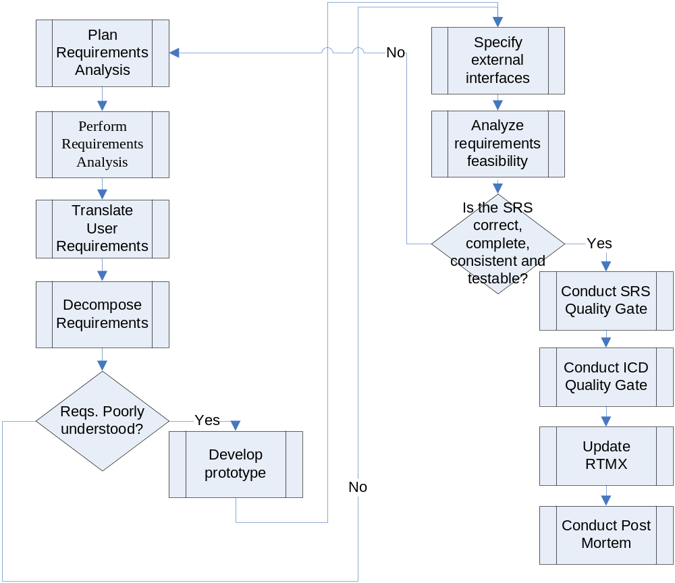
Requirements Analysis Process
Notes:
Plan Requirements Analysis: involves the selection of the appropriate models for analysis and the preparation of the environment.
Perform Requirements Analysis: involves the analysis of the requirements necessity and the specification of the functional models.
Translate user requirements: analysts shall translate the user requirements stated in the REQB into product requirements.
Decompose Requirements: involves the decomposition of each requirement into a set of testable primitive requirement.
Prototyping: if poorly understood requirements are still specify, the analysts shall develop some prototypes in order to clarify those requirements.
Specify external interfaces: the system external interfaces shall be identified in the ICD.
Analyze requirements feasibility: this feasibility should be checked against he budget and schedule availability.
Check SRS: involves the verification of the SRS for completeness, consistency and testability.

Slide 76
Requirements Analysis Process
Exit Criteria:
  SRS document has been approved.
Outputs:
  System/Software Requirements Specification (SRS).
  Updated Traceability Matrix (RTMX).
  Prototypes, Simulations, Model scenarios, Storyboards (optional).
  Initialized Interface Control Document (ICD).
Metrics:
  Faults from reviews (Errors and Defects).
  Cycle time and effort spent on the activity, preview, review and rework effort.
  Size of SRS.
  PCE.

Slide 77
Requirements Analysis Process
Requirements Analysis Techniques (Example)
  UML
  SDL
Notes:
UML
UML notation set is a language and not a methodology.
The most useful, standard UML diagrams are: use case diagram, class diagram, sequence diagram, state chart diagram, activity diagram, component diagram, and deployment diagram
SDL (Specification and Description Language):
A modeling language used to describe real time systems.
SDL is used to model the details of a system, which can be simulated and proven, whereas UML is used to model at a higher level of abstraction.
There are three parts to an SDL diagram: the system definition, block and process.

Slide 78
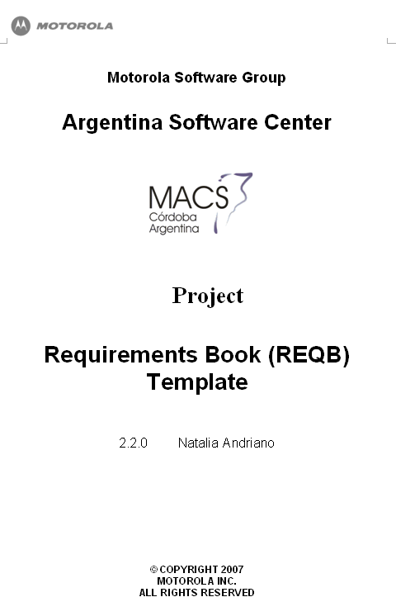
REQB vs. SRS
Requirements Book (REQB)
  Describes the scope of the work to be done. The boundary of the work shall be clearly set, by specifying what will be done and more importantly what will not be done.
  Establishes the basis in the agreement between the client and the supplier.
Software Requirements Specification (SRS)
  Contains all the details the software developer needs to create a design.
  Specifies how the inputs to the software should be transformed into outputs.

Slide 79
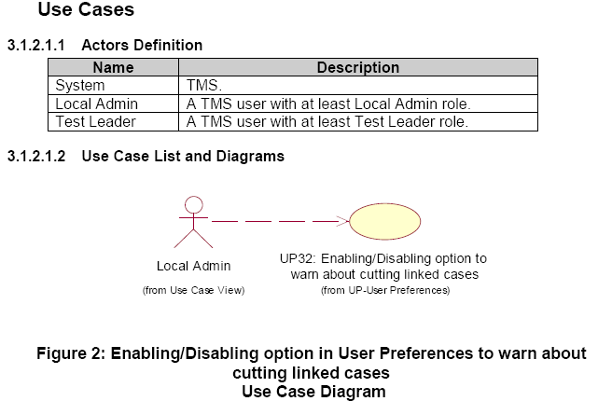
REQB vs SRS (Practical Example)
REQB
  TMSCQ00000847-1 – GUI for showing a warning message when cutting Cases: TMS must show a GUI that specifies the complete path where all the linked case items will be cut. The path format must be as follow: “Loadline Title/Project Name/Suite ID”.
SRS
  TMSCQ00000847 – Enhance warning message when cutting cases linked multiple times.
  Requirement Description: When a User selects one or more case items for being cut, TMS must check if the selected case items are linked under linked suites and show a warning message specifying all the places where the linked case items must be cut. This message must be configurable, so a new option in the Miscellaneous tab of the User Preferences window must be added to enable/disable the warning message that must appear when cutting linked case items

Slide 80
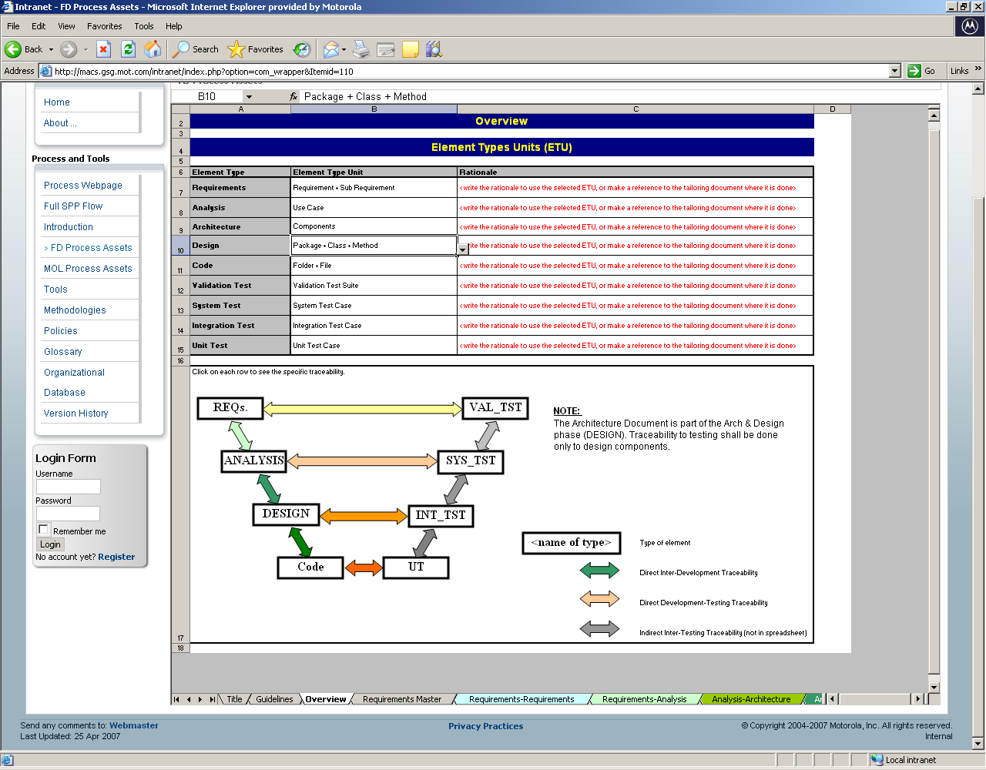
Requirements Traceability
Notes:
When the requirements are managed well, traceability can be established
from the source requirement to its lower level requirements and from
the lower level requirements back to their source. Such bidirectional
traceability helps determine that all source requirements have been
completely addressed and that all lower level requirements can be
traced to a valid source.
Requirements traceability can also cover the relationships to other
entities such as intermediate and final work products, changes in design
documentation, and test plans.
Traceability is particularly needed in conducting the
impact assessment of requirements changes on the project's activities
and work products.
Typical Work Products
1. Requirements traceability matrix
2. Requirements tracking system

Slide 81
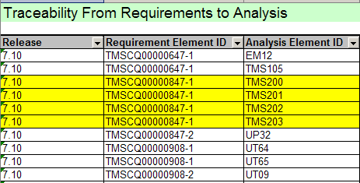
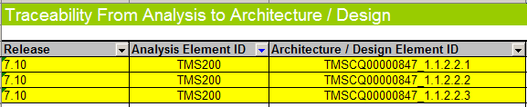
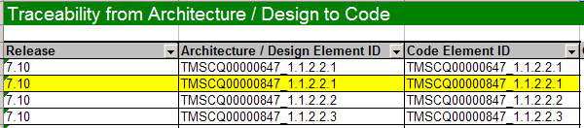
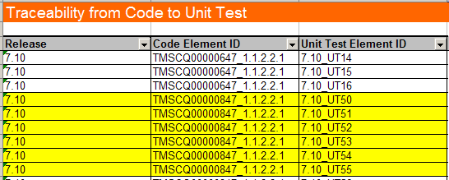
Traceability Matrix (RTMX) - Example
Notes:
Traceability matrix [RTMX] will be initialized based on defined requirements. The RTMX gives us the possibility to track changes throughout the life of the project, and it also helps us to perform and impact analysis, when changes are proposed. The bi-directional traceability matrix between REQB and any relevant input can also be stated, as appropriate.

Slide 82
Good practices when creating requirements
Management | Elicitation | Analysis | Specification | V&V
Define change control process | Write vision and scope | Draw context diagram | Adopt SRS template | Inspect requirements documents
Establish change control board | Define requirements development procedure | Create prototypes | Identify sources of requirements | Write test cases from requirements
Perform change impact analysis | Identify user classes | Analyze feasibility | Label each requirement | Write a user manual
Trace each change to all affected work products | Select product champions | Prioritize requirements | Record business rules | Define acceptance criteria.
Baseline and control versions of requirements documents | Establish focus groups | Model the requirements | Create traceability matrix
Maintain change history | Identify use cases | Create a data dictionary
Track requirements status | Analyze user workflow
Measure requirements stability | Define quality attributes
Use a requirements management tool | Examine problem reports
 | Reuse requirements
Literature Good Practices
Motorola Experience Good Practices

Slide 83
Change History
Version | Date | Comments | Author
A1 | 27 Jul 2001 | New E-ITP SPE Week 1
A2 | 30 Aug 2001 | Reformatted and fixed typos, split into 2 presentations
A3 | 2 Nov 2001 | Fixed a few typos
A4 | 20 Dec 2001 | Minor changes based on feedback from Austin
A5 | 1 Sep 2003 | Many slides were change according to GSG Argentina SPP
A6 | 21 Feb 2006 | Changed Design Phase name to Architecture And Design
A7 | 22 Feb 2006 | Split Requirements Gathering and Planning phase into Project Planning and Requirements Development. Requirements Analysis phase was merged into Requirements Development.
A8 | 02 Jun 2006 | Update SPP flow
2.0.0_Draft_A | 05 Jun 2006 | Changes to SPP flow | Natalia Andriano
2.0.0 | 07 Jun 2006 | Baseline after RAITAR17012 | Natalia Andriano
2.1.0_Draft_A | 26 Nov 2007 | Changes to “Requirements Development Phase” section | Alfonsina Altamira María Fernanda Carignano
2.1.0_Draft_B | 12 Dec 2007 | Practical Examples were added. REQB vs SRS. New template. | Natalia Andriano
2.1.0_Draft_C | 13 Dec 2007 | Changes according to RAITAR30044 | Natalia Andriano
2.1.0 | 17 Dec 2007 | Baseline after FTR | Natalia Andriano

